Slide 1

Path Coordination System (PCS) – Capacity Broker
Introduction: General info
START: 10:00

Slide 2
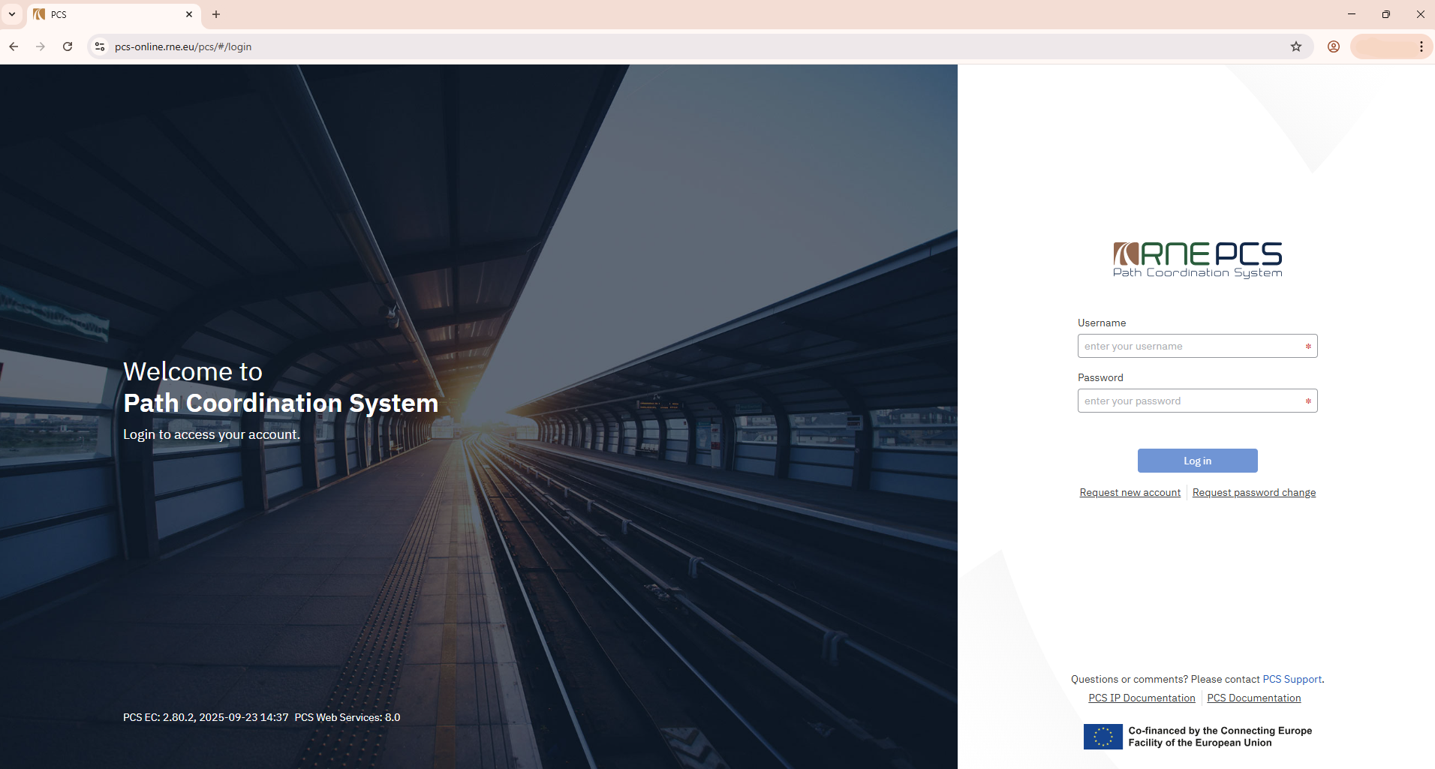

Slide 3
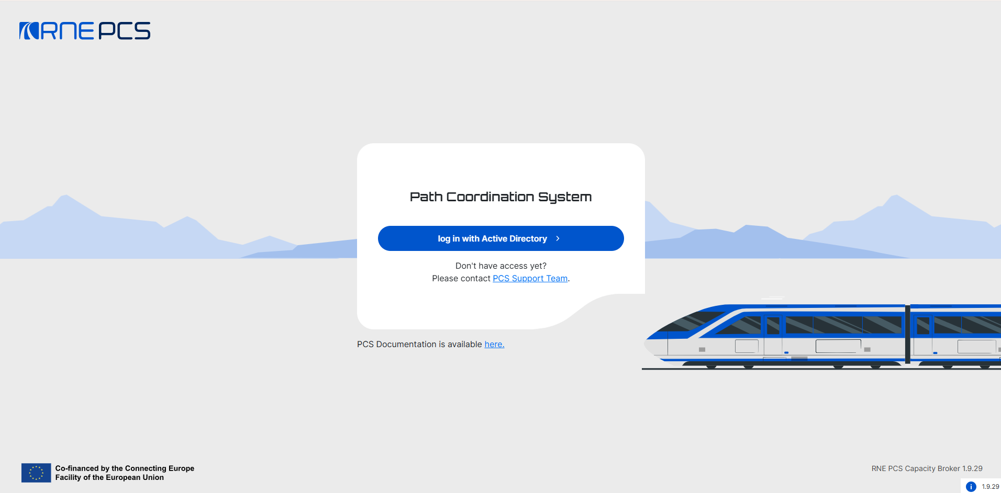

Slide 4
Agenda
  Key dates & plan for usability improvements
  Hands-on
    Documentation website
      Planned next training sessions
    Support contact
    System environments
      For testing
        How to log in (SSO basics)
      Migrated data/production system preview
    Layout
    Terminology EC vs. CB
    Basic steps of the „dossier“ creation (not a detailed training)
    Demo – from sending the Path Request to accepting the final offer
  Q&A time
    (camera & microphone of users)

Slide 5
Key dates
EC: Last day of usage - 13th of November
CB: First day of usage - 20th of November
Nov 25
Week | MON | TUE | WED | THU | FRI | SAT | SUN
44 |  |  |  |  |  | 1 | 2
45 | 3 | 4 | 5 | 6 | 7 | 8 | 9
46 | 10 | 11 | 12 | 13 | 14 | 15 | 16
47 | 17 | 18 | 19 | 20 | 21 | 22 | 23
48 | 24 | 25 | 26 | 27 | 28 | 29 | 30

Slide 6
Post-go-live roadmap
Analyzing issue reports and identifying a Backlog of 200+ items
Categorization based on usage period in TTP
Prioritization* & definition of release packages
Nov 17th Go-live
Beginning of December release
End of January release
March release
Improvements for TTP2028

Slide 7
Hands-on

Slide 8

PCS CB: pre-production-sandbox
https://cb-pre-prod-sandbox.rne.eu/pcs-cb/
Usage of generic company test accounts
Hide who you are → incognito browser
  No impact on your daily business

