Slide 1


PCS CB - API - Introduction and Training session - Session 4
Notes:
clearPlaceholders
Category_EN:Title Slides
Title_EN:Timetable Redesign
Tags_EN:Title;Start;Image;Presentation title

Slide 2
Table of Content
Introduction
Documentation focus: PCS CB API – Testing Guide
Documentation focus: PCS CB API – Settings and non-production API configurations
Live demonstration
Questions and Anwers

Slide 3
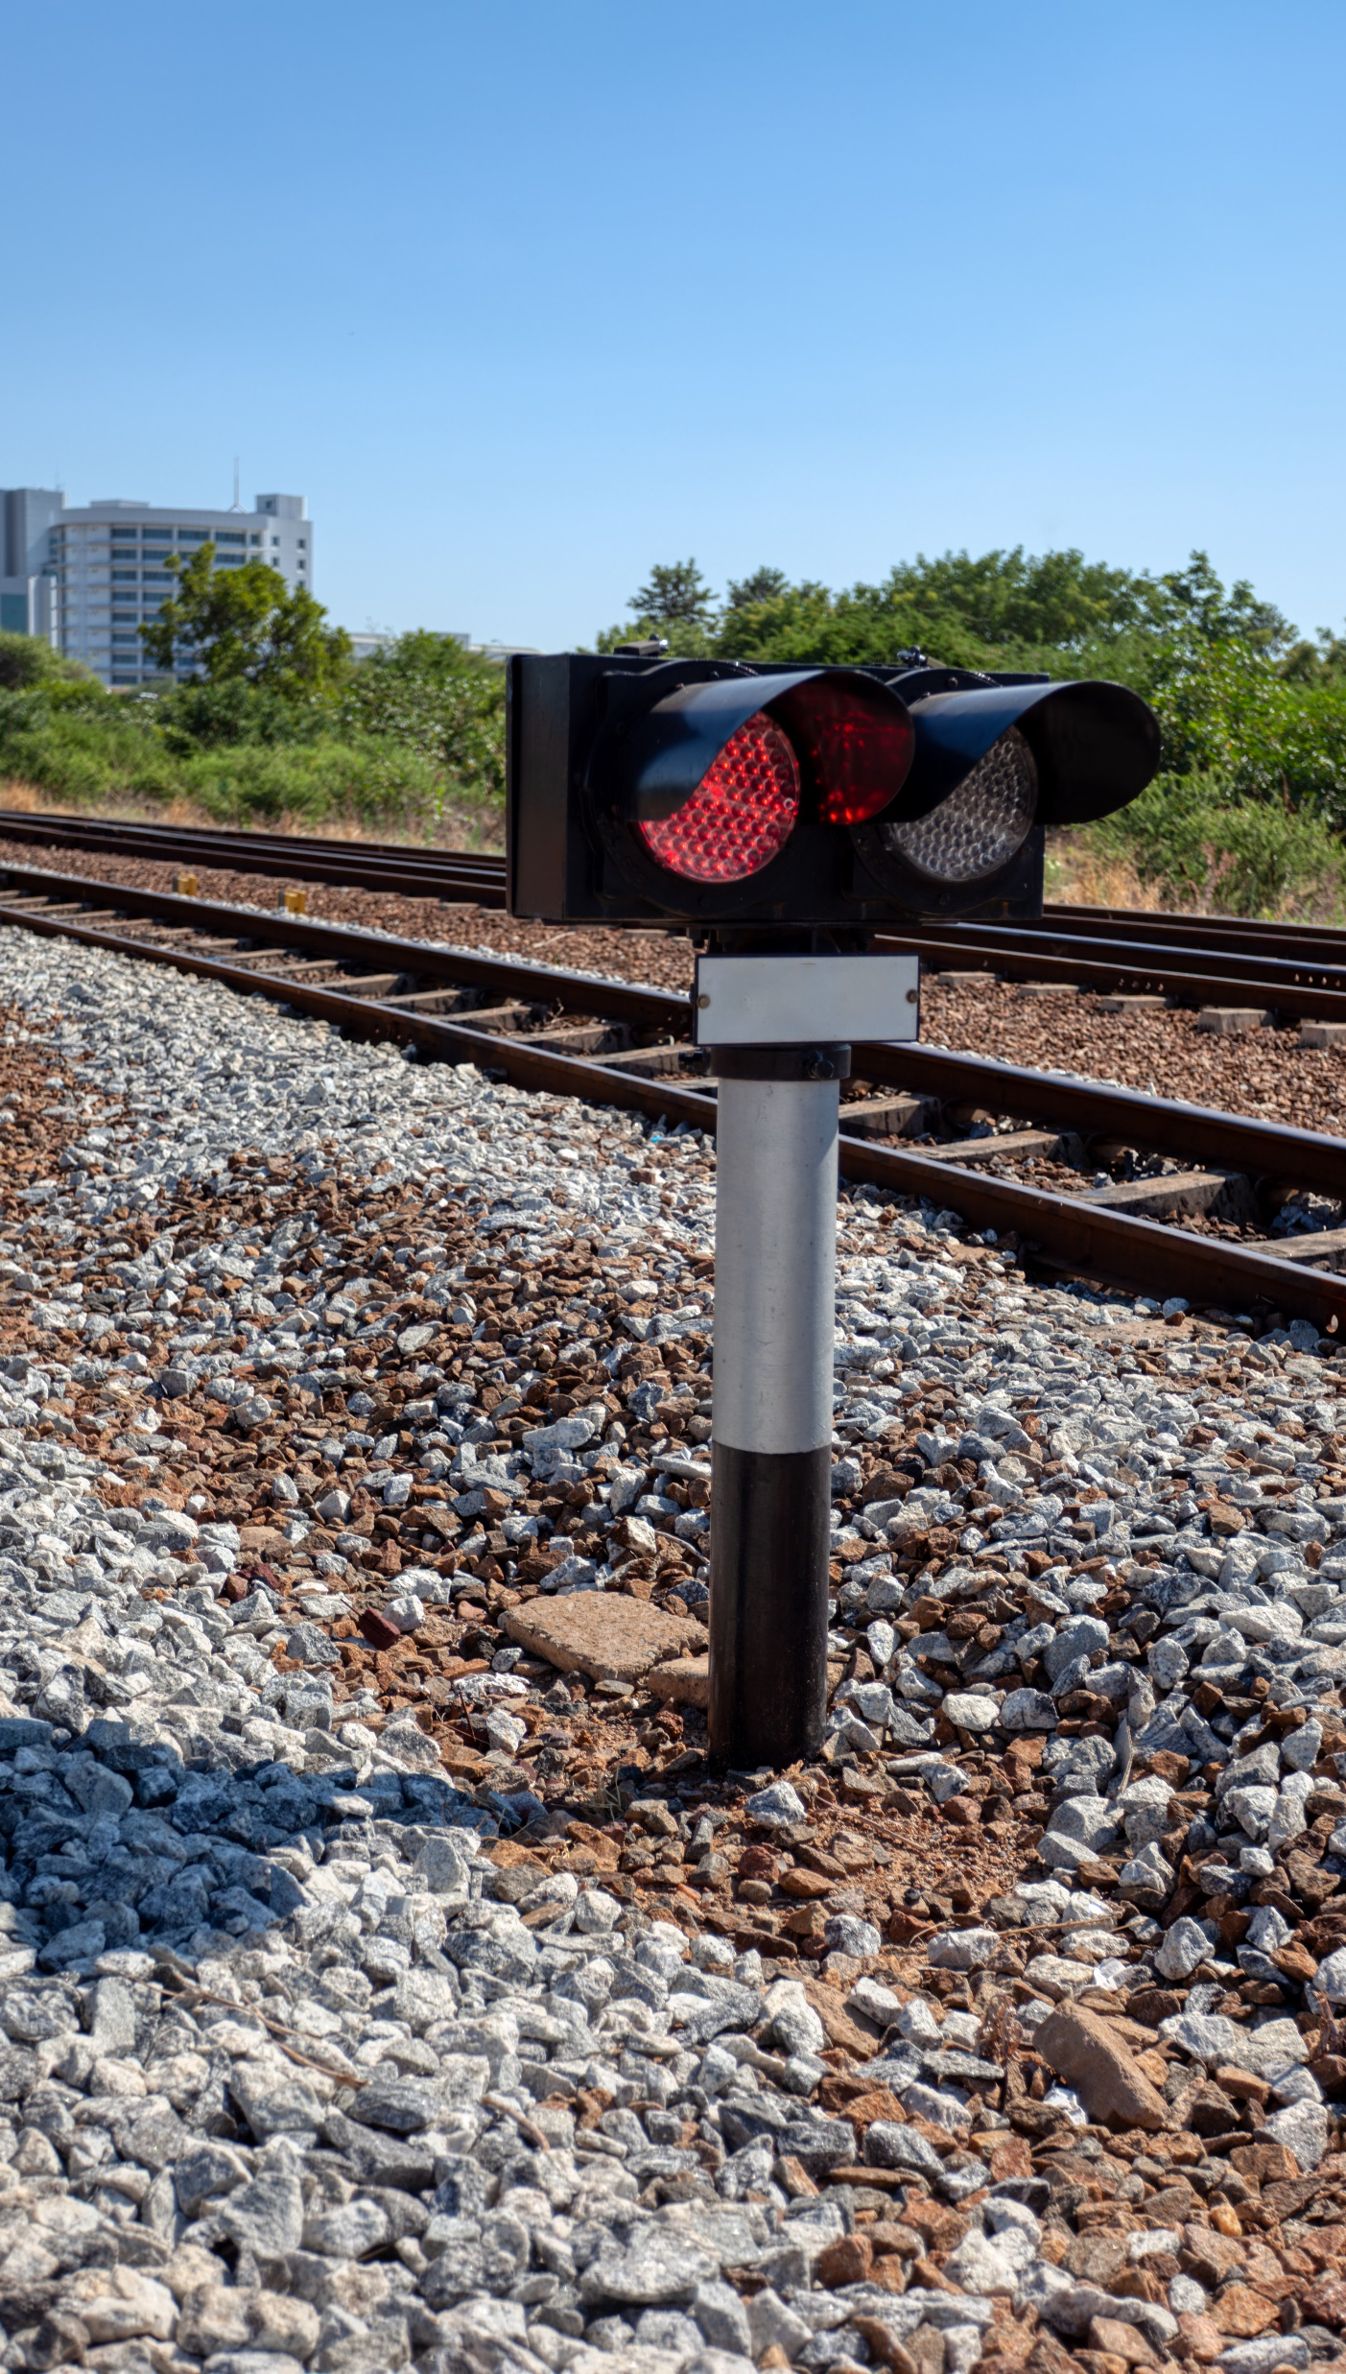
Introduction
01

Slide 4
November 2025 introduction and training sessions
Materials of all introduction and training sessions
Documentation available under this link (publicly accessible)
Recommended prior knowledge for participants and viewers of the meeting recordings
Familiarity with TAF/TAP TSI
Participation or viewing of GUI and API previous introduction and training sessions (list available under this link)
By the end of this session 4, participants and recording viewers will be able to:
Understand the first steps when testing to PCS CB via the API
Better navigate through the main concepts of the technical specifications (process flows, message sequences, actions)

Slide 5
Documentation focus: PCS CB API – Testing Guide
02

Slide 6
Documentation focus: PCS CB API – Testing Guide
PCS CB API - Testing Guide – v1​
Documentation available under this link (publicly accessible)
RNE Joint Office – PCS Support: support.pcs@rne.eu (for all communications about PCS: questions etc)

Slide 7
Documentation focus: PCS CB API – Settings and non-production API configurations
03

Slide 8
Documentation focus: PCS CB API – Settings and non-production API configurations
PCS CB API – Settings and non-production API configurations – v1​
Documentation available under this link (publicly accessible)
RNE Joint Office – PCS Support: support.pcs@rne.eu (for all communications about PCS: questions etc)

Slide 9
Live demonstration
04

Slide 10
Live demonstration
"Reference train creation by the Leading Applicant" action (New Path Request process) ​
Action IDs 1 and 4 - PCS CB Technical Specifications – Appendix A​
Recording: from 21:00:00 to 30:00:00​
"Path request creation/update and finalisation" action (New Path Request process) ​
Action IDs 35, 30, 50 - PCS CB Technical Specifications – Appendix A​
Recording: from 30:00:00 to 34:00:00​
“Draft offer creation/update by an Involved IM" action (New Path Request process) ​
Action IDs 108, 114 - PCS CB Technical Specifications – Appendix A​
Recording: from 34:00:00 to 39:00:00​

Slide 11
Questions and Answers
05

Slide 12
Questions and Answers
No questions asked by the meeting participants

Slide 13
RNE Joint Office – PCS Support team: support.pcs@rne.eu

