Slide 1


PCS CB - API - Introduction and Training session - Session 3 – Start at 09:00
Notes:
clearPlaceholders
Category_EN:Title Slides
Title_EN:Timetable Redesign
Tags_EN:Title;Start;Image;Presentation title

Slide 2
PCS CB - API - Introduction and Training session - Session 3
Notes:
clearPlaceholders
Category_EN:Title Slides
Title_EN:Timetable Redesign
Tags_EN:Title;Start;Image;Presentation title

Slide 3
Table of Content
Introduction
Questions and Anwers (focus: topics of session 1 to 3)
Conclusion

Slide 4
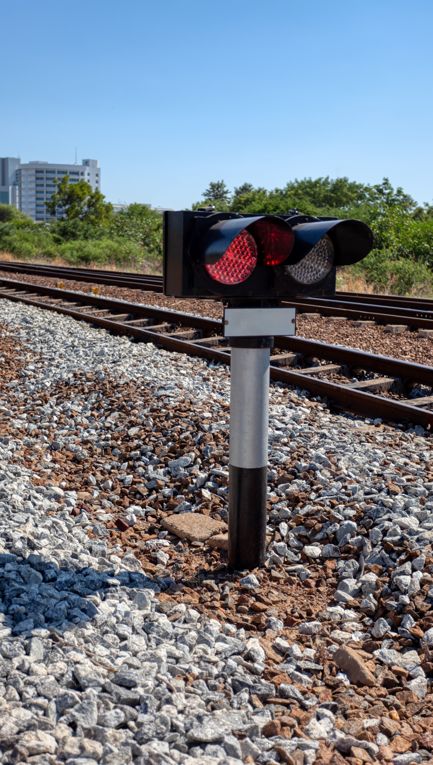
Introduction
01

Slide 5
November 2025 introduction and training sessions
Materials of all introduction and training sessions
Documentation available under this link (publicly accessible)
Recommended prior knowledge for participants and viewers of the meeting recordings
  Familiarity with TAF/TAP TSI
  Participation or viewing of GUI and API previous introduction and training sessions (list available under this link)
  RNE Joint Office – PCS Support: support.pcs@rne.eu (for all communications about PCS: questions etc)

Slide 6
Questions and Answers
02

Slide 7
Questions and Answers
Question 1
  Marija Prsa – Croatian Railwas Voyageurs: where are the details about the IDs visible on the message sequences available?
  Answer - RNE JO: in column A of appendix A from the technical specifications.
Question 2
  Marija Prsa – Croatian Railwas Voyageurs: we are not yet supporting the xsd.schema version 3.4.1.0. Should we connect to PCS CB?
  Answer - RNE JO: yes at least establing the heartbeat between the common interfaces. The message exchanges can be tested once you have upgraded to 3.4.1.0.
Question 3
  Marija Prsa – Croatian Railways Voyageurs: when does RNE configures its CI? Once all details applicants and IMs have shared their connection details with RNE?
  Answer - RNE JO: the configuration is done upon request from each interfacing company.
Question 4
  Marija Prsa – Croatian Railways Voyageurs: where is the code list of type of information codes located?
  Answer - RNE JO: in the sector xsd.schema.

Slide 8
Conclusion
07

Slide 9
Conclusion – Session 3
For a more hands-on experience on the introduction and training session 4, 5 and 6:
  Preliminary review by the participants of the actions, sub-actions and message sequences concepts (session 1 – Agenda point 4)
  Participation or viewing of the GUI and API previous introduction and training sessions (available under this link)

Slide 10
RNE Joint Office – PCS Support team: support.pcs@rne.eu

