Slide 1


PCS CB - API - Introduction and Training session - Session 2
Notes:
clearPlaceholders
Category_EN:Title Slides
Title_EN:Timetable Redesign
Tags_EN:Title;Start;Image;Presentation title

Slide 2
Table of Content
Introduction
Documentation focus: PCS CB API - FIRST STEPS FOR CONNECTING
Live demonstration
General Questions and Anwers
Conclusion

Slide 3
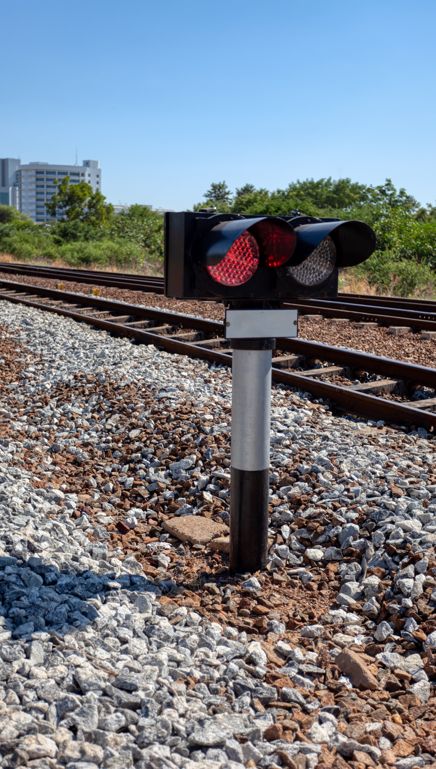
Introduction
01

Slide 4
November 2025 introduction and training sessions
Materials of all introduction and training sessions
Documentation available under this link (publicly accessible)
Recommended prior knowledge for participants and viewers of the meeting recordings
Familiarity with TAF/TAP TSI
Participation or viewing of GUI and API previous introduction and training sessions (list available under this link)
By the end of this session 2, participants and recording viewers will be able to:
Understand the first steps when connecting to PCS CB via the API
Navigate through the main concepts of the technical specifications (process flows, message sequences, actions)
RNE Joint Office – PCS Support: support.pcs@rne.eu (for all communications about PCS: questions etc)

Slide 5
Documentation focus: PCS CB API -First steps for connecting
02

Slide 6
The first steps for connecting to PCS CB API
PCS CB API - FIRST STEPS FOR CONNECTING – v1
Documentation available under this link (publicly accessible)
Questions and Answers
Question 1
Fabrice Julien - SNCF Voyageurs: is it possible to export the reference data?
Answer - RNE JO: yes. There is an export feature to excel for the network specific parameters, loco types, operation points and activity types.
Question 2
Fabrice Julien - SNCF Voyageurs: is the codification of the locos unified between the IMs? Answer - RNE JO: yes. There is an export feature to excel for the network specific parameters, loco types, operation points and activity types.
Answer - RNE JO: the codification may be aligned between some IMs but there is no restriction / requirement in PCS. There was an initiative at the sector level to achieve a unified codification: RNE JO will check about its status.
Question 3
Vincent Feichtenschlager - ÖBB-Infrastruktur AG: are IMs allowed to deactivate all the predefined activity types and only use their own ones?
Answer - RNE JO: it may be an edge case probably technically possible. RNE JO will check if there is an additional restriction.

Slide 7
Live demonstration
03

Slide 8
Live demonstration
"Path request creation/update by an Involved Applicant" action (New Path Request process)
Action ID 25 and 30 - PCS CB Technical Specifications – Appendix A
Recording: from 00:37:00 to 00:47:00
"Feasibility Study start by the Leading Applicant" action
Action ID 263 to 266 - PCS CB Technical Specifications – Appendix A
Recording: from 00:47:00 to 00:53:00
“Study creation/update and finalisation by an Involved IM" action
Action 267, 268 and 269 - PCS CB Technical Specifications – Appendix A
Recording: from 00:53:00 to 00:59:00

Slide 9
Live demonstration
Questions and Answers
Fabrice: export of ref data, loco types

Slide 10
Questions and Answers
04

Slide 11
Questions and Answers
Question 1
Fabrice Julien - SNCF Voyageurs: where are the details about the IDs visible on the message sequences available?
Answer - RNE JO: in column A of appendix A from the technical specifications.
Question 2
Marek Neustadt – OLTIS: “Study creation/update and finalisation by an Involved IM" action – Is the OIM only sent to the Leading IM? Opinion: the OIM is not needed by the Leading IM.
Answer - RNE JO: it is a mistake. The diagram will be updated. The OIM is sent to all involved IMs.

Slide 12
Conclusion
05

Slide 13
Conclusion – Session 2
For a more hands-on experience on the introduction and training session 4, 5 and 6:
GUI access to RNE CI logs by the participants during the live demonstration: participants can send an access request to support.pcs@rne.eu by 06.11 EOD – Email subject: “PCS CB API – November training session – RNE CI access request
Preliminary review by the participants of the action, sub-actions and message sequences concepts (session 1 – Agenda point 4)
Participation or viewing of the GUI and API previous introduction and training sessions (available under this link)
RNE Joint Office – PCS Support: support.pcs@rne.eu (for all communications about PCS: questions etc)

Slide 14
RNE Joint Office – PCS Support: support.pcs@rne.eu (for all communications about PCS: questions etc)

